Slide 1
Conducting a Large-Scale User Study on Scientific Text Simplification
Kyuri Im (TU Dresden)
kyuri.im@mailbox.tu-dresden.de

Slide 2
Table of Content
Motivation
Objective and Outline
Dataset
User Survey
Evaluation
Future Work
Conclusion

Slide 3
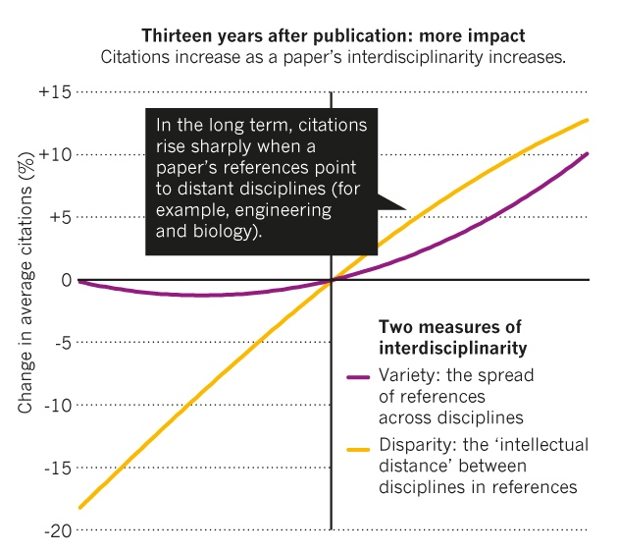


Motivation
Source: J. Wang et al. PLoS ONE 10, e0127298 (2015)
Interdisciplinary Research is booming,
driving innovation across domains like biology, engineering, and computer science.
Scientific literature remains difficult to access,
especially for researchers
outside the originating field.
Academic papers with
dense jargon and complex structures, limited engagement and cross-domain understanding.

Slide 4
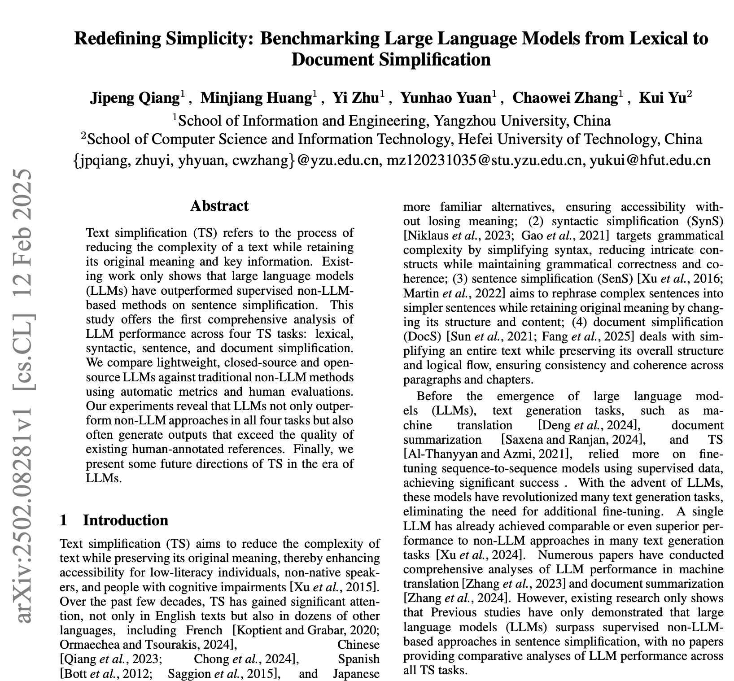
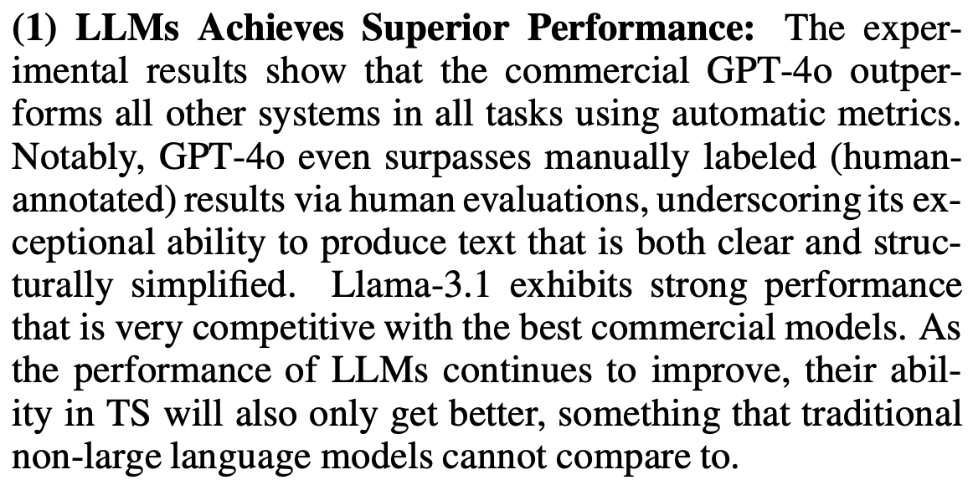
Motivation (cont.)
While Large Language Models provide
promising performance on simplifying text,
Current tools lack domain-aware evaluation and
high-quality, user-informed datasets.

Slide 5
Project Objective and Outline
Primary Goal:
to create a high-quality dataset that serves as a resource for training and evaluating AI methods for text simplification
Main Purpose:
Develop and evaluate LLM-based methods to make academic texts accessible to researchers from other fields and lay audiences
Generate a set of gold simplified summaries of scientific paper that
Respect the integrity of the original text,
Are faithful to the source,
And are tailored for non-expert readers in interdisciplinary settings.

Slide 6
Select Scientific Corpus
SciSummNet

Slide 7
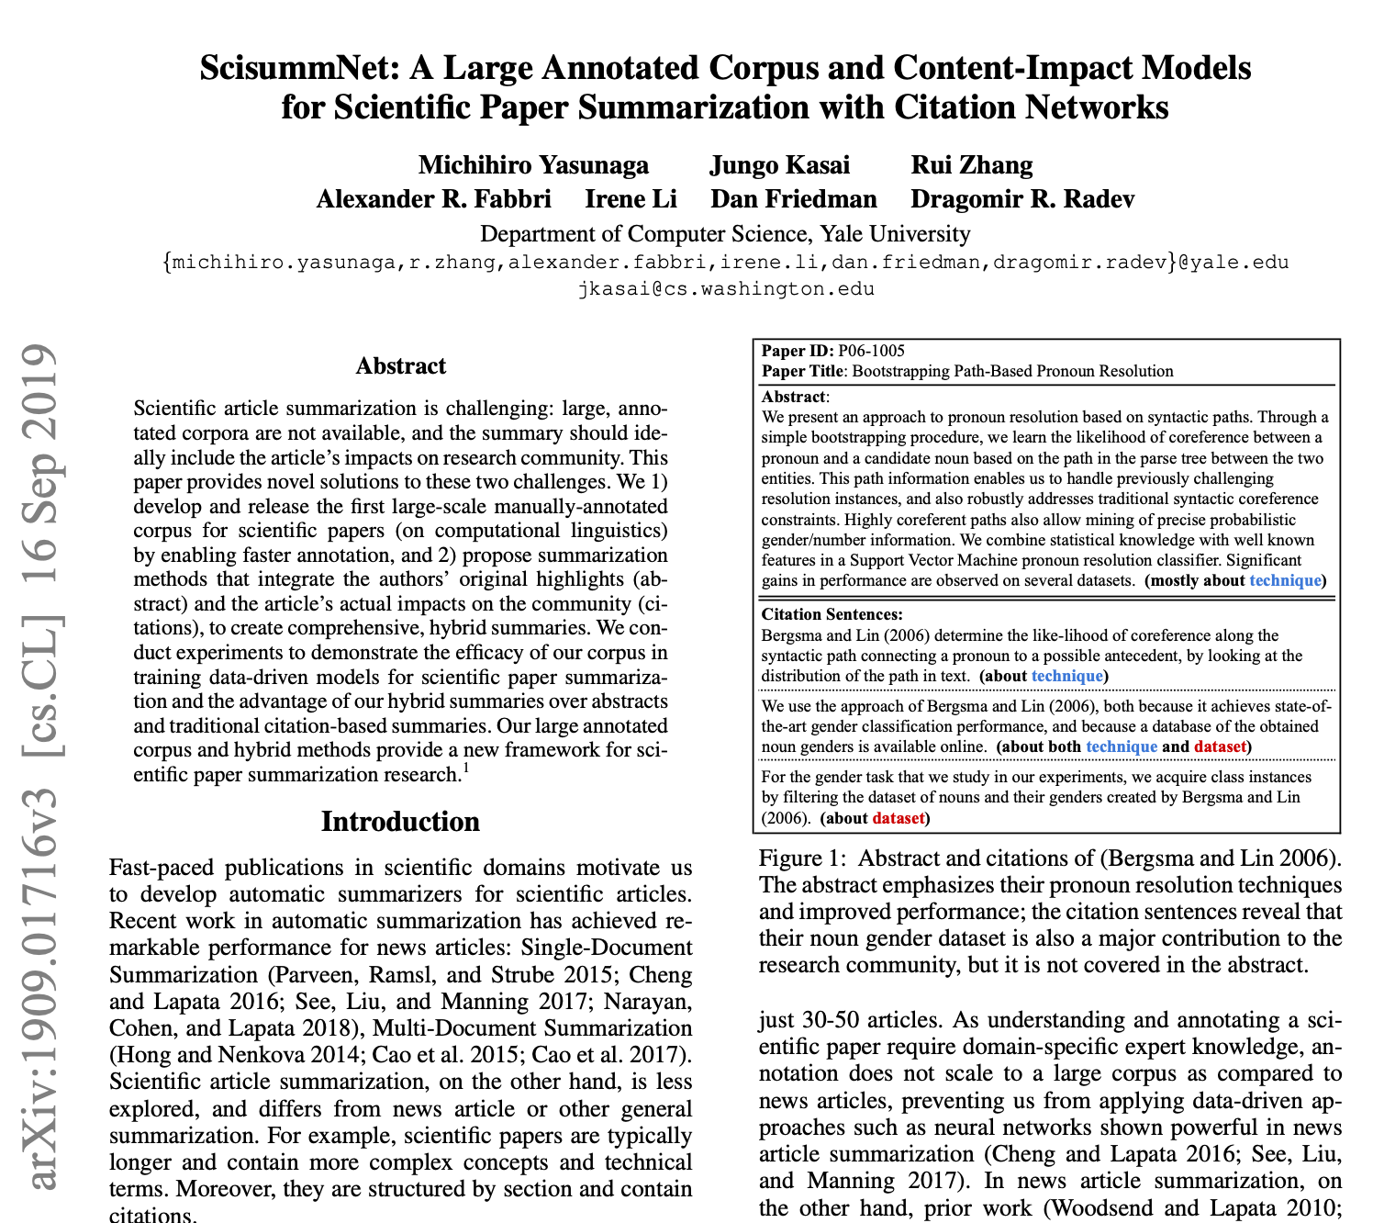
Select Scientific Text Corpus - SciSummNet
SciSummNet contains Top Most Cited 1.0K papers from ACL
Summarize Abstract of the paper and Citation Contexts
Abstract captures key ideas of the paper in structured manner
Citation contexts provides more complete picture of the research problem in the paper
Provide gold-summary of the paper from the experts

Slide 8
Select Scientific Text Corpus - SciSummNet
SciSummNet Summary Example
This paper describes the role of supertagging in a wide-coverage CCG parser which uses a log-linear model to select an analysis. The supertagger reduces the derivation space over which model estimation is performed, reducing the space required for discriminative training. … We show that large increases in speed can be obtained by tightly integrating the supertagger with the CCG grammar and parser. … . Our scores give an indication of how supertagging accuracy corresponds to overall dependency recovery. We describe two log-linear parsing models for CCG: a normal-form derivation model and a dependency model. The CCG parsing consists of two phases: first the supertagger assigns the most probable categories to each word, and then the small number of combinatory rules, plus the type-changing and punctuation rules, are used with the CKY algorithm to build a packed chart.
Summary includes average of 150 words with key findings, in contrast to the original document’s 4700 words.

Slide 9
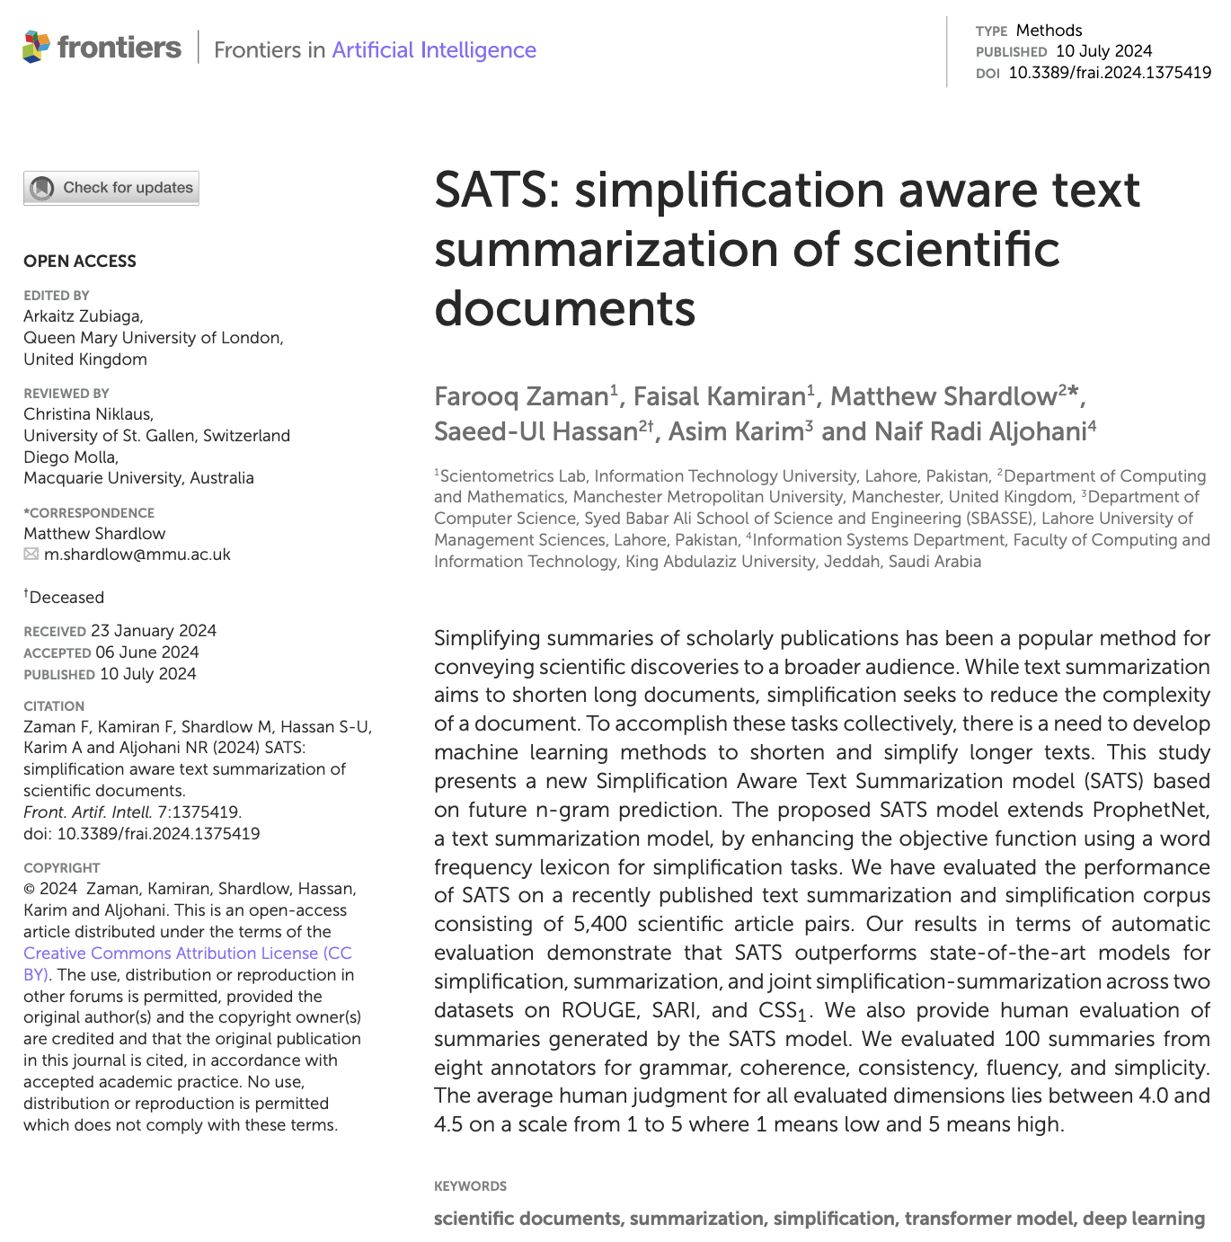
Generate GPT4-Simplified Summary
Model : GPT-4o-mini
Prompt : {
"role" : "system",
"content" : "You are a language expert whose goal is to simplify the given text easy to read and understand for non-experts in scientific field and general public. While simplifying, detect any complex words or key phrases. Do not change the format of the paragraph or add new line."
},
{"role": "user",
"content" : "Simplify the following text. Keep simplified results in the same line. The first line is the title of the paper so keep the first line as it is in the result and move on to the next line for simplification. Put the first line(title) and the simplified texts in the same line. :{text}"
}
“… if a text is only summarized, technical words may remain, impeding a reader. If it is only simplified, the resulting text might be too long and repetitive. Therefore, having both simplification and summarization is vital for true understanding in heterogeneous areas such as public health literature, legal texts, or scientific communications.”
Zaman et al.[2024]
Notes:
I take this set of summaries from SciSummNet and generated simplified scientific summaries using GPT-4o-mini.
This initial text simplification serves as baseline texts for the following simplification task in the next step.

Slide 10
User Study
Evaluate, Annotate, and Generate

Slide 11
User Study Design
Phase 1
Phase 2
Main Goal
To annotate complex phrases or words that require further simplification.
To evaluate the level of simplification of the scientific text.
Main Task
Given a set of pairs of Original Summary and GPT-Simplified text,
Compare clarity, coherence and English grammar.
Mark complex sentences both from the original and GPT-Simplified summaries.
Main Goal
To generate the gold-level simplified summary.
Main Task
Given a set of the original and GPT-Simplified summaries, both annotated from Phase 1, generate gold-simplified summary of scientific paper.

Slide 12
User Study Design—Phase 1 Collecting User Feedback on Language Complexity
Goal
Assess how understandable the scientific summaries are to non-experts STEM readers
Participants
STEM background, fluent in English
Shown original vs. GPT-simplified summaries
Asked to click sentences they found complex or unclear
Randomization
Order of summaries are randomized to prevent bias
participants don’t recognize which is simplified

Slide 13
User Study Design—Phase 1 Evaluation Framework and Annotation Interface
Evaluation Dimension :
Simplicity
Is the language easier to understand?
Are the sentences less complicated, shorter than the original?
Information Coherence
Does the simplified text retain the original meaning and flow?
English Fluency
Is the text grammatically correct and natural?
Annotation Interface :
Highlight complex sentences both from the original and GPT-simplified summaries
Mark specific words

Slide 14
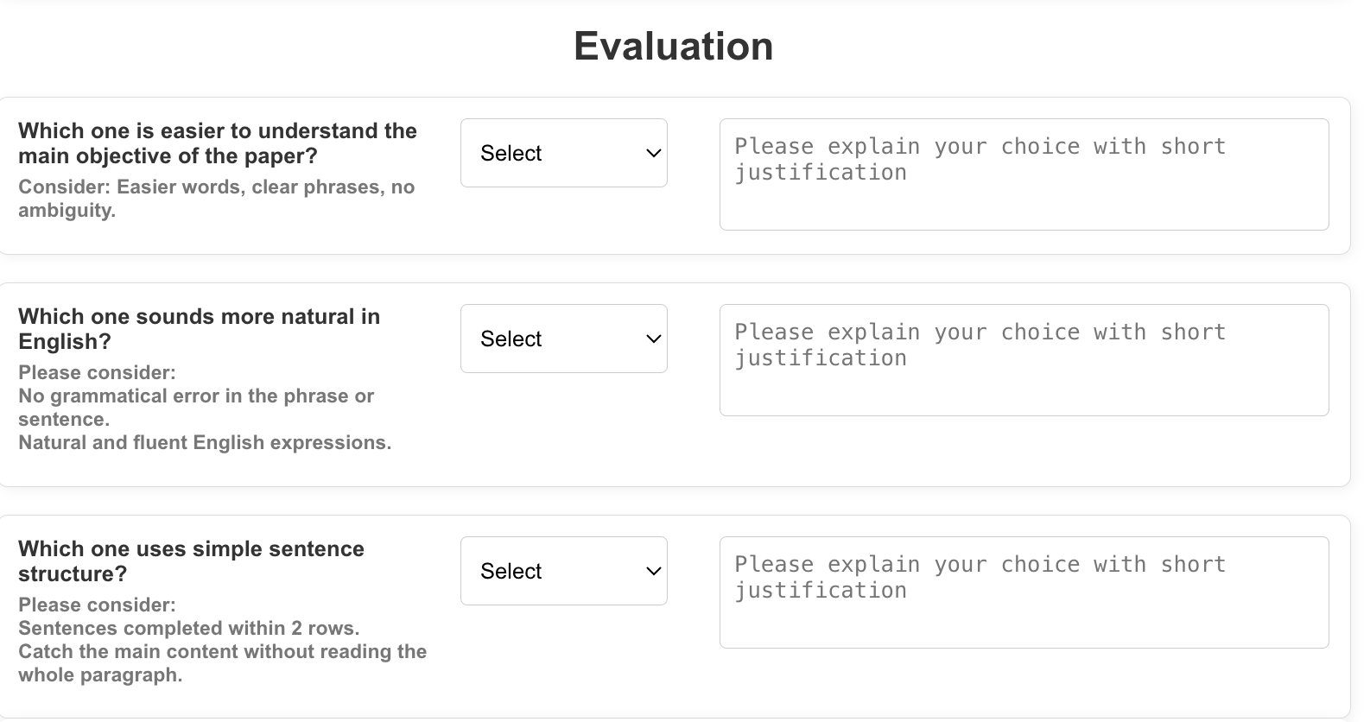
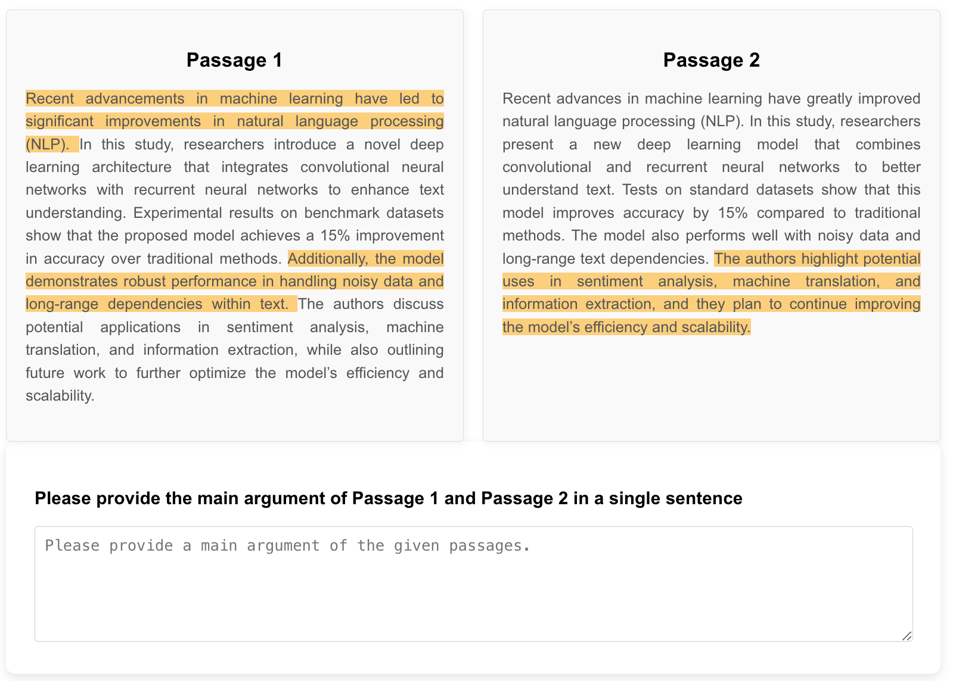
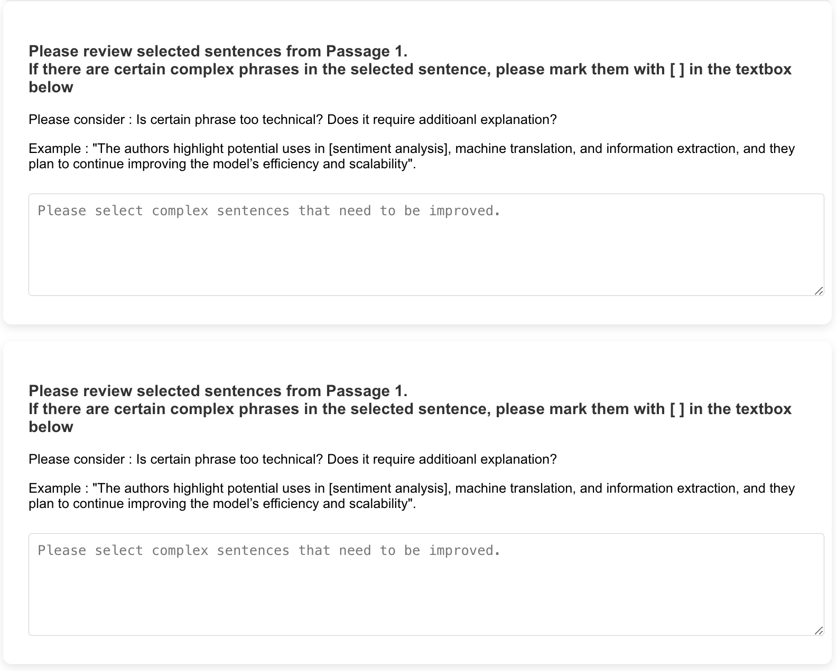
User Study Design—Phase 1 Survey Layout
Short Justification
Information Coherence
Highlight complex sentences
English Fluency
Simplicity
Attention Check Question
Mark complex words or phrases with [ ] from the highlighted sentences

Slide 15
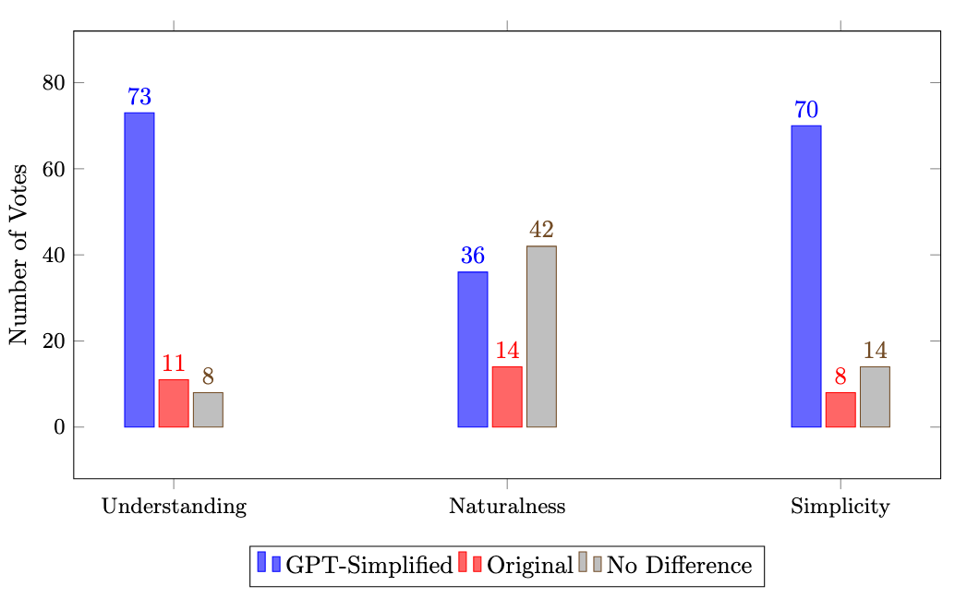
Evaluation – Phase 1 Distribution of Ratings
Participant Preference across evaluation dimensions
GPT-simplified leads in
Understanding - Information Coherence
Simplicity
Majority of participants answered
no difference in English Fluency

Slide 16
Evaluation – Phase 1 Information Coherence (Understanding) Comment
Understanding: “GPT-Simplified summary explains the technical words better.”
”Original": "This paper defines a generative probabilistic model of parse trees, which we call PCFG-LA. This model is an extension of PCFG in which non-terminal symbols are augmented with latent variables. Fine-grained CFG rules are automatically induced from a parsed corpus by training a PCFG-LA model using an EM-algorithm. Because exact parsing with a PCFG-LA is NP-hard, several approximations are described and empirically compared. In experiments using the Penn WSJ corpus, our automatically trained model gave a performance of [86.6% (F1, sentences <= 40 words)], which is comparable to that of an unlexicalized [PCFG parse]r created using extensive manual feature selection. We use a markovized grammar to get a better unannotated parse forest during decoding, but we do not markovize the training data. We right-binarize the tree bank data to construct grammars with only unary and binary productions.",
”GPT-Simplified": “This paper describes a method for creating parse trees, which are structures used in understanding sentences, called PCFG-LA. This method improves upon a basic version known as PCFG by adding hidden elements to the symbols used in the trees. Detailed rules for constructing these trees are automatically learned from a collection of example sentences by training the PCFG-LA model using a technique called the EM-algorithm. Since finding an exact solution with PCFG-LA is very complex and difficult (NP-hard), the paper discusses several simplified methods and compares them through experiments. In tests with a well-known set of sentences (Penn WSJ corpus), our model, which was trained automatically, performed quite well with an accuracy of 86.6% for sentences up to 40 words long, similar to another model that required a lot of manual adjustment. We use a special method (markovized grammar) to get better results when interpreting sentence structures but do not apply this method to the training examples. We also change the structure of example sentence data to make it simpler, using only two types of constructions (unary and binary).

Slide 17
Evaluation – Phase 1 Naturalness and Simplicity
Naturalness: “Passage 1 sounds a little more natural overall.
Its word choices (“arbitrary threshold,” “notion of correctness,” “sentence-level QE system”) match standard academic English and read smoothly, whereas some substitutions in Passage 2—such as “idea of correctness is not easy to understand” and “chosen limit”—feel slightly informal or awkward. Both passages are grammatically correct, but Passage 1’s vocabulary and phrasing align better with conventional, fluent scholarly style..”
Simplicity : Passage 1—its sentences are a little shorter and have fewer parenthetical insertions or stacked phrases, so each idea is delivered in a cleaner, more easily digestible structure.
”Original": "We present a detailed study of confidence estimation for machine translation. Various methods for determining whether [MT] output is correct are investigated, for both [whole sentences] and [words]. Since the [notion of correctness] is not intuitively clear in this context, different ways of defining it are proposed. We introduce a [sentence-level QE system] where an [arbitrary threshold] is used to classify the [MT output] as good or bad. Since the notion of correctness is not intuitively clear in this context, different ways of defining it are proposed. We present results on data from the NIST 2003 Chinese-to-English MT evaluation. We introduce a sentence level QE system where an arbitrary threshold is used to classify the MT output as good or bad. We study sentence and word level features for translation error prediction.",
”GPT-Simplified": "We present a detailed study of confidence estimation for machine translation. Various methods for determining whether MT (Machine Translation) output is correct are investigated, for both whole sentences and words. Since the [idea of correctness] is not easy to understand in this context, different ways of defining it are proposed. We introduce a [sentence-level QE (Quality Estimation) system] where a chosen limit is used to classify the [MT output] as good or bad. We present results on data from the NIST 2003 Chinese-to-English MT evaluation. We introduce a sentence level QE (Quality Estimation) system where a chosen limit is used to classify the MT output as good or bad. We study sentence and word level features for translation error prediction."

Slide 18
From Phase 1
GPT simplification improved overall simplicity of technical terms and sentence structure with promising English fluency
However…
Naturalness in Scientific field
Fluency in scholarly style
Simple and understandable while maintaining formality
Human Annotation is necessary

Slide 19
Phase 2 – Ask experts to simplify the summary
Task Instructions: Simplifying Scientific Summaries
Objective: Your task is to further simplify the given Annotated Summary, particularly focusing on the phrases inside [ ]. The goal is to make the text clearer, more readable, and accessible while preserving the original meaning. This will help us create high-quality, simplified scientific text.
Instructions:
Read the Original Summary: This is the original, complex version of the scientific text.
Review the Annotated Summary: This version has already simplified but may still contain complex phrases.
Further Simplify Phrases in [ ]: Focus on the phrases inside [ ] and rewrite them in simpler terms while keeping their meaning intact.
Ensure Readability: The final version should be clear and easy to understand for a general audience.

Slide 20
Phase 2 : Generate Gold Simplified Summary
Total 92 Summaries
Target Participants
People pursuing/holding Master’s Degree or above in Computer Science
People pursuing/holding Bachelor’s Degree in Computer Science with working experience as a research assistant

Slide 21
Phase 2 : Generate Gold Simplified Summary Instructions
✍ Simplification Instructions
When simplifying, please carefully consider the presence of [ ] brackets in the summaries.
There are four possible cases you need to handle:
Case 1: Both original and simplified summaries contain [ ]
- For the original summary, check that phrases in brackets are well simplified in the simplified version, preserving meaning and grammar. - For the simplified summary, rephrase bracketed words/phrases to keep clarity and original meaning.
Case 2: Only the original contains [ ] - Verify that the bracketed phrases in the original are simplified appropriately in the simplified summary, maintaining meaning and correctness.
Case 3: Only the simplified contains [ ] - For the simplified, rephrase bracketed terms to clearly preserve the original meaning.
Case 4: Neither contains [ ] - Review the simplified summary to ensure it clearly conveys the core meaning. - Rephrase sentences if needed to improve readability and flow.
Notes:
For phase 2, I provided both original summary and GPT-simplified summary with annotations from the previous step.
To utilize user feedback

Slide 22
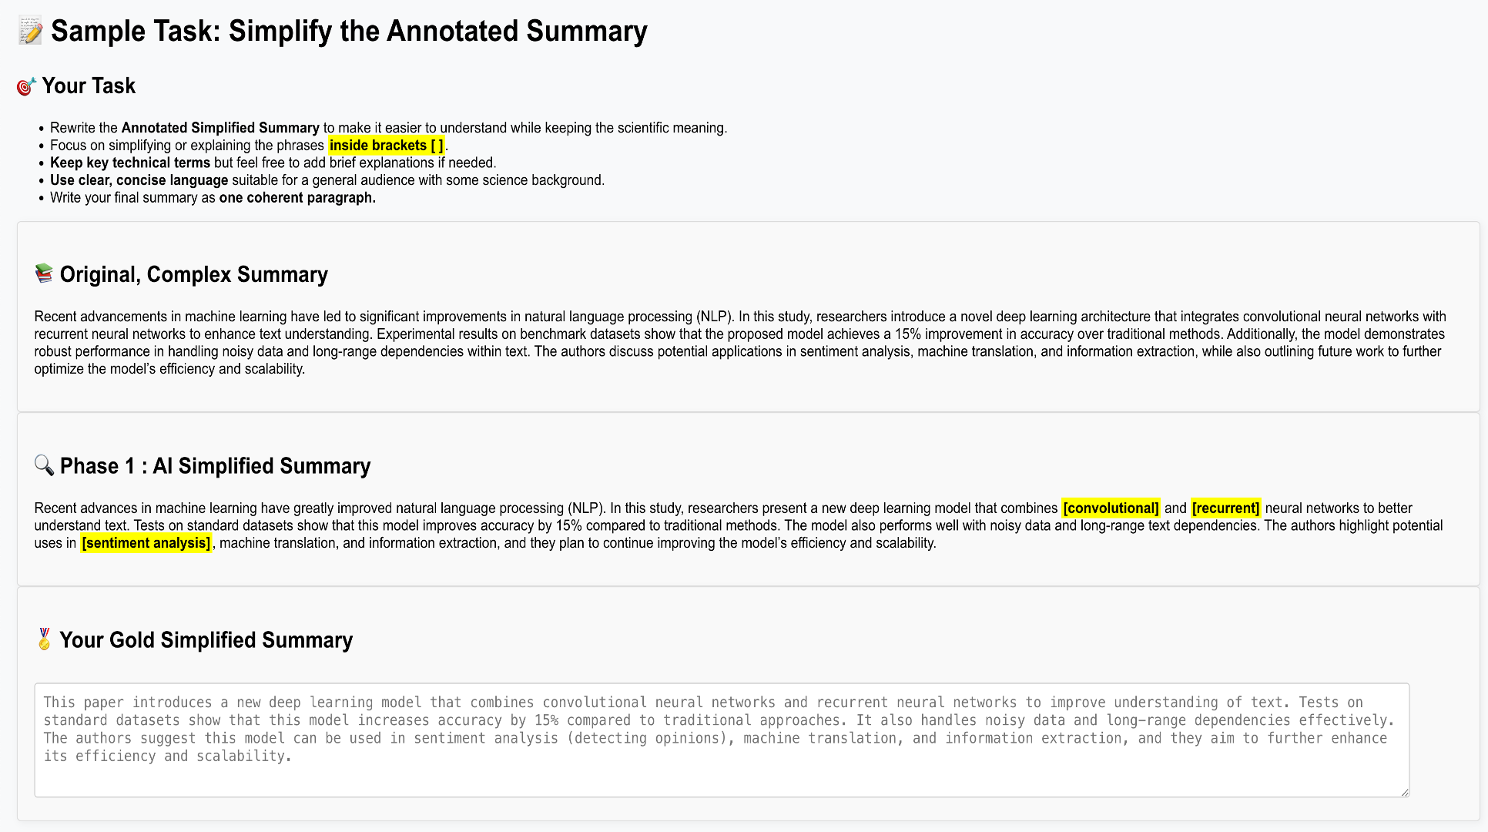
Phase 2 : Generate Gold Simplified Summary

Slide 23
Evaluation Comparison
Category |  | GPT-Simplified | Human-Simplified
Semantics | BLEU | 0.9490 | 0.3490
 | LENS | 53.7663 | 50.5648
 | BERTScore Precision | 0.9880 | 0.8999
 | BERTScore Recall | 0.9936 | 0.9066
 | BERTScore F1 | 0.9907 | 0.9031
 | Paraphrase Similarity (sentence transformer based) | 0.9880 | 0.9046
Simplicity | SARI | 46.7589 | 33.7167
 | SAMSA | 0.3094 | 0.2530
 | Compression | 1.0522 | 1.0286
 | Avg Word Length (Original : 5.3866) | 5.4163 | 5.7087
 | Avg Sentence Length (Original : 164.4255) | 172.0851 | 167.7447
Readability | FK Grade Level | 12.10 | 13.00
 | FK Reading Ease | 48.54 | 40.89
Notes:
GPT’s outputs are extremely close in surface form to the originals. That’s why BLEU is near 1. Humans paraphrase more, so overlap is much lower. (High BLEU here mostly signals minimal rewriting, not “better simplification.”)
Small GPT lead. LENS aims to reflect adequacy/fluency with a learned model; both are in a similar band, suggesting both versions keep the core meaning reasonably well, with GPT a bit closer.
BERT Score Very high for GPT → near-paraphrase of the source at the semantic embedding level. Precision and recall both ~0.99 means GPT keeps almost all content and words/phrases semantically aligned. Human ~0.90 indicates heavier rephrasing/abstraction, not necessarily worse meaning, just less source-like.

Slide 24
Phase 2 : Generate Gold Simplified Summary
PRINCIPAR - An Efficient Broad-Coverage Principle-Based Parser
(Original)
We present an efficient, broad-coverage, principle-based parser for English. The parser has been implemented in C++ and runs on SUN Sparcstations with X-windows. It contains a lexicon with over 90,000 entries, constructed automatically by applying a set of extraction and conversion rules to entries from machine readable dictionaries. We release MiniPar, a fast and robust parser for grammatical dependency relations.
(GPT-Simplified)
We introduce an efficient English language parser that uses broad rules to understand sentences. The parser is built using C++ and works on SUN Sparcstations with a graphical interface called X-windows. It includes a word list (lexicon) with over 90,000 entries, created automatically by using rules to extract and convert data from digital dictionaries. We also offer MiniPar, a quick and reliable tool for analyzing grammatical connections between words.
(Human-Simplified)
This paper introduces PRINCIPAR, an efficient and broad-coverage principle-based parser for the English language. Implemented in C++ for SUN Sparcstations with X-windows, it features a lexicon of over 90,000 entries automatically built from machine-readable dictionaries using extraction and conversion rules. The authors also provide Minipar, a fast and robust parser designed for analyzing grammatical dependency relations.
Dataset is available : https://github.com/kim33/Scientific-Text-Simplification.git

Slide 25
Phase 2 : Generate Gold Simplified Summary
Complex Syntax: Building A Computational Lexicon
(Original)
We describe the design of Complex Syntax, a computational lexicon providing detailed syntactic information for approximately 38,000 English headwords. We consider the types of errors which arise in creating such a lexicon, and how such errors can be measured and controlled. Our COMLEX syntax dictionary provides verb subcategorization information and syntactic paraphrases, but they are indexed by words thus not suitable to use in generation directly.
(GPT-Simplified)
We explain how we created Complex Syntax, a computer-based dictionary that gives detailed grammar information for about 38,000 main English words. We look at the kinds of mistakes that can happen when making this dictionary, and how we can find and fix these mistakes. Our COMLEX syntax dictionary includes details about how verbs are used and different ways to say things in sentences, but because they are organized by words, it is not easy to use them for creating new sentences directly.
(Human-Simplified)
This paper details the design of Comlex Syntax, a computational lexicon offering extensive syntactic information for approximately 38,000 English headwords. The authors discuss the types of errors that can occur during lexicon creation and methods for their measurement and control. This COMLEX syntax dictionary provides verb subcategorization information and syntactic paraphrases, but because these are indexed by individual words, they are not directly suitable for generating new sentences.
Dataset is available : https://github.com/kim33/Scientific-Text-Simplification.git

Slide 26
Limitation and Challenges
Limited Number of Gold Simplified Summary
Due to the lack of participants for user study, about 4.9% of the corpus were evaluated
Small subset may not reflect domain complexity, linguistic variation, and summarization difficulty present in the full dataset
Findings may not generalize to the entire corpus
Additional Human Evaluation of Gold Simplified Summary
Current assessment leans on automatic metrics
These metrics miss nuance in scientific simplification
Additional human annotation phase with target users to judge conceptual clarity, relevance improves the result.

Slide 27
Conclusion
Scientific Text Simplification
User Study Pipeline : GPT-4o-mini drafts + User Feedback + Expert Revision
Outcome : Gold Standard simplified summaries that keep rigor while improving accessibility of computer science paper for interdisciplinary research
Research Findings
LLM alone is not enough
strong readability and semantic fidelity but miss domain nuance and claim strength
Expert revision matters
Preserves key terminology
Improves structure and selectively reuses clear GPT phrasing -> better fit for interdisciplinary users
Notes:
While GPT-generated simplifications offer strong surface-level read-
ability and semantic fidelity, human refinement is essential for improving structural simplicity, preserving
domain-specific meaning, and enhancing overall accessibility for interdisciplinary audiences

Slide 28
Thank You

